Slide 1
CTS 6319 Cyber Security: Measurement and Data Analysis
Dr. Elias Bou-Harb
ebouharb@fau.edu EE 503B
Office hours: Mondays 4-6pm

Slide 2
Material
On Canvas
Research Papers 5 & 6:
Survey and taxonomy of botnet research through life-cycle
Your botnet is my botnet: analysis of a botnet takeover

Slide 3
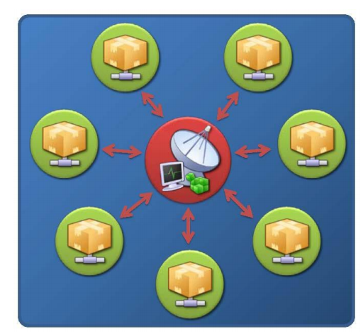
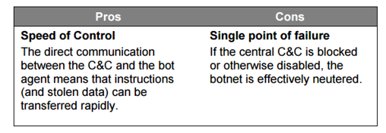
Botnet Topologies-Star

Slide 4
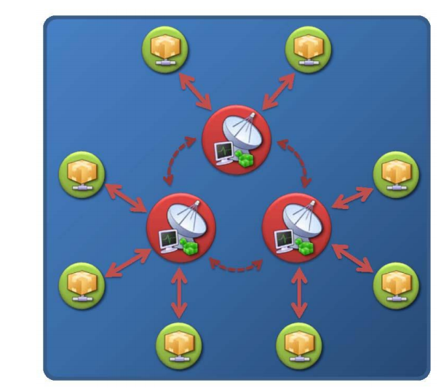
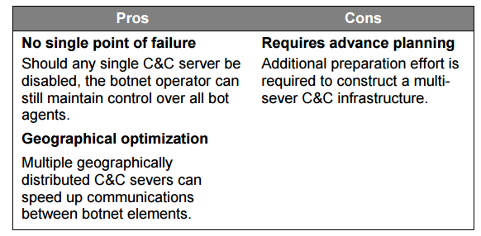
Botnet Topologies-Multi Server

Slide 5
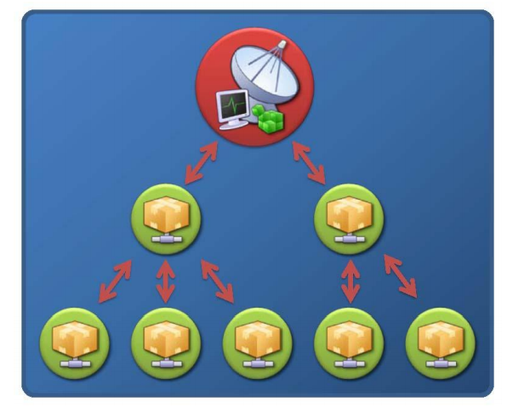
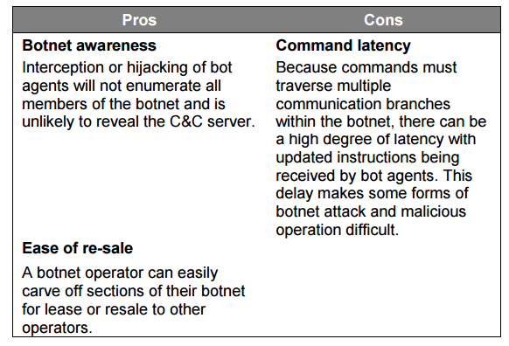
Botnet Topologies-Hierarchical

Slide 6
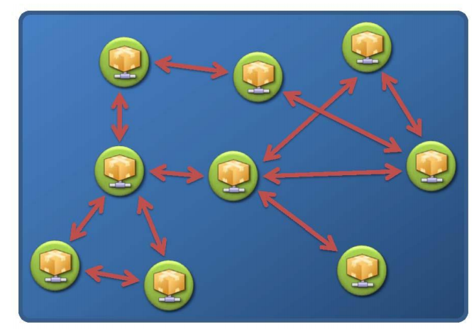
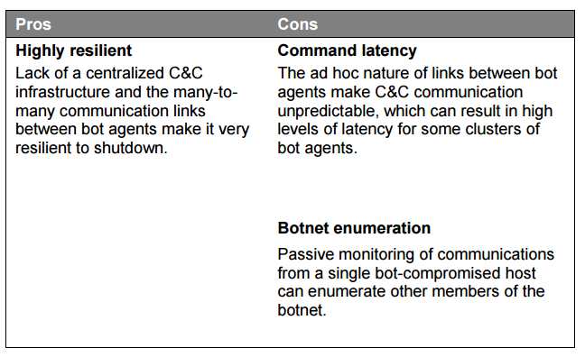
Botnet Topologies-Random (p2p)

Slide 7
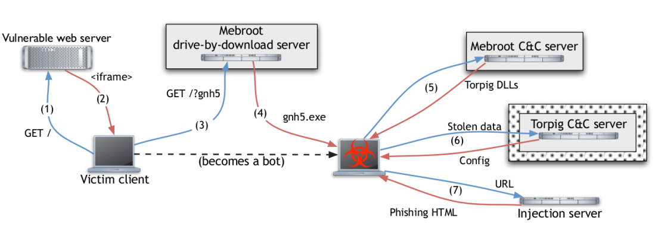
Analysis of the Torpig Botnet
Using a passive approach; operating a bot and a C&C server
A Trojan horse in reality
Initially a drive-by-download infection

Slide 8
Analysis of the Torpig Botnet
Bot installs Mebroot, a platform for managing the bots’ modules
Modifies Master Boot Record
Modules saved in encrypted folder under system32

Slide 9
Analysis of the Torpig Botnet
Mebroot contacts C&C server every 2hrs using HTTP POST
Injects 29 modules in different applications (cmd.exe, ie, skype, ftp clients, etc.)

Slide 10
Analysis of the Torpig Botnet
Every 20 minutes, bot contact C&C to upload stolen info
HTTP POSTS messages using an encoding scheme

Slide 11
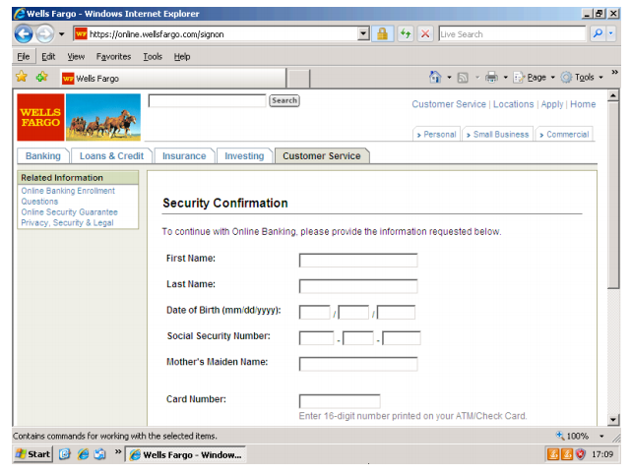
Analysis of the Torpig Botnet
C&C server messages
okn: ack
okc: congif (frequency to contact C&C, hard coded backup servers, etc.)
Exploits phishing

Slide 12
Analysis of the Torpig Botnet
Domain flux
Similar to IP fast-flux techniques but a bit more sophisticated
Query a certain domain (instead of IPs) that is mapped onto a set of IP addresses, which change frequently
Torpig bot uses a a domain generation algorithm to get list of domains
Botmaster need to control only one domain

Slide 13
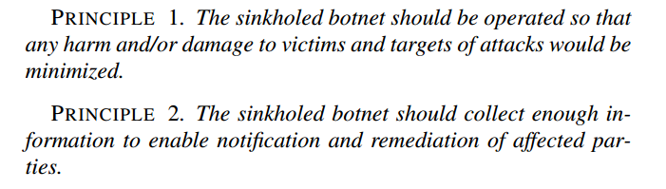
Analysis of the Torpig Botnet
Taking control of the botnet
Data Collection Principles

Slide 14
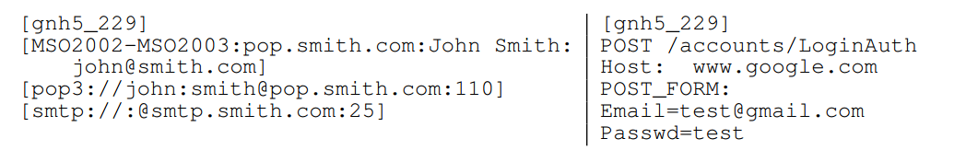
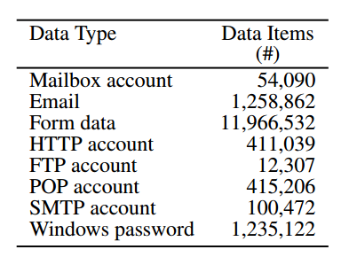
Analysis of the Torpig Botnet
Data Collection

Slide 15
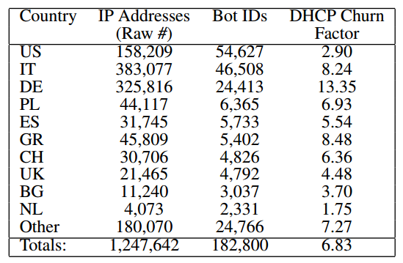
Analysis of the Torpig Botnet
Botnet size
Botnet footprint: total number of machines that have been compromised over time
Botnet live population: number of compromised hosts that are simultaneously communicating with the C&C server

Slide 16
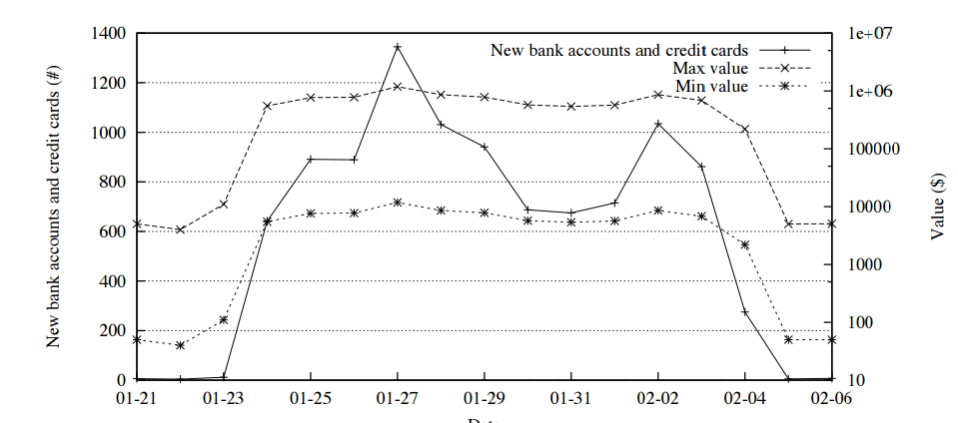
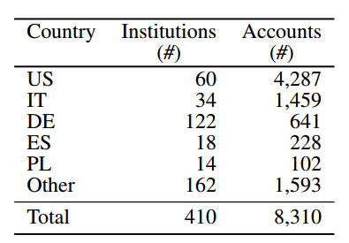
Analysis of the Torpig Botnet
Theft of financial data

Slide 17
Analysis of the Torpig Botnet
Password analysis from stolen data
28% of the victims reused their credentials for accessing 368,501 web sites
56,000 passwords were recovered in less than 65 minutes
30,000 additional passwords were recovered in the next 24 hours by brute force

Slide 18
Analysis of the Torpig Botnet
Some lessons learned
A naive evaluation of botnet size based on the count of distinct IPs yields grossly overestimated results
The malware problem is fundamentally a cultural problem
Interacting with registrars, hosting facilities, victim institutions, and law enforcement is a rather complicated process

Slide 19
CTS 6319 Cyber Security: Measurement and Data Analysis
Dr. Elias Bou-Harb
ebouharb@fau.edu EE 503B
Office hours: Mondays 4-6pm
http://faculty.eng.fau.edu/ebouharb/

